Slide 1

SOFT 252 Assignment
Mike Jones - 10020665
Wing Chau - 10563222
Radu-Adrian Marcu - 10528506
Notes:
Hello, my name is Radu and this is a short presentation of our group project.
There will be notes on each slide, as well audio guidance to make this a more pleasant experience.

Slide 2
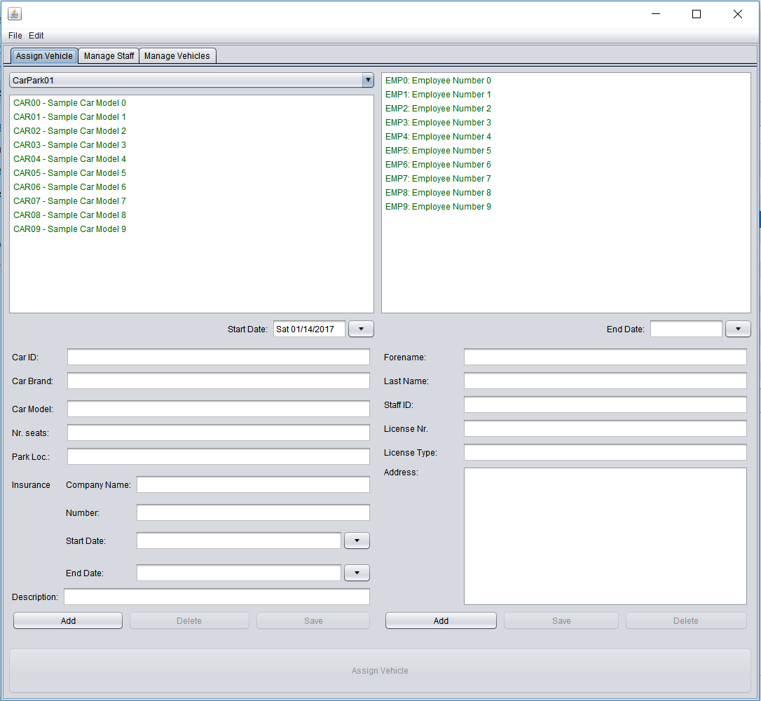
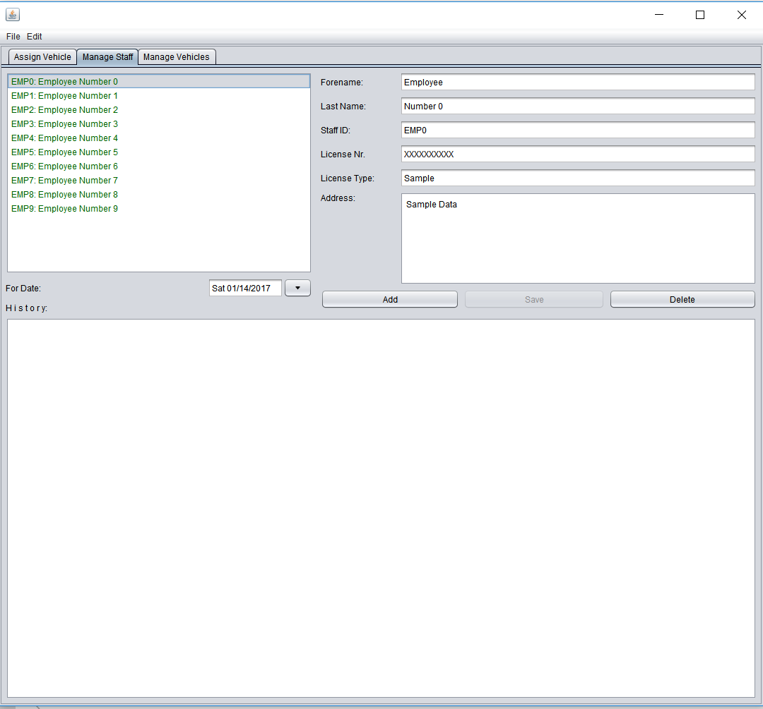
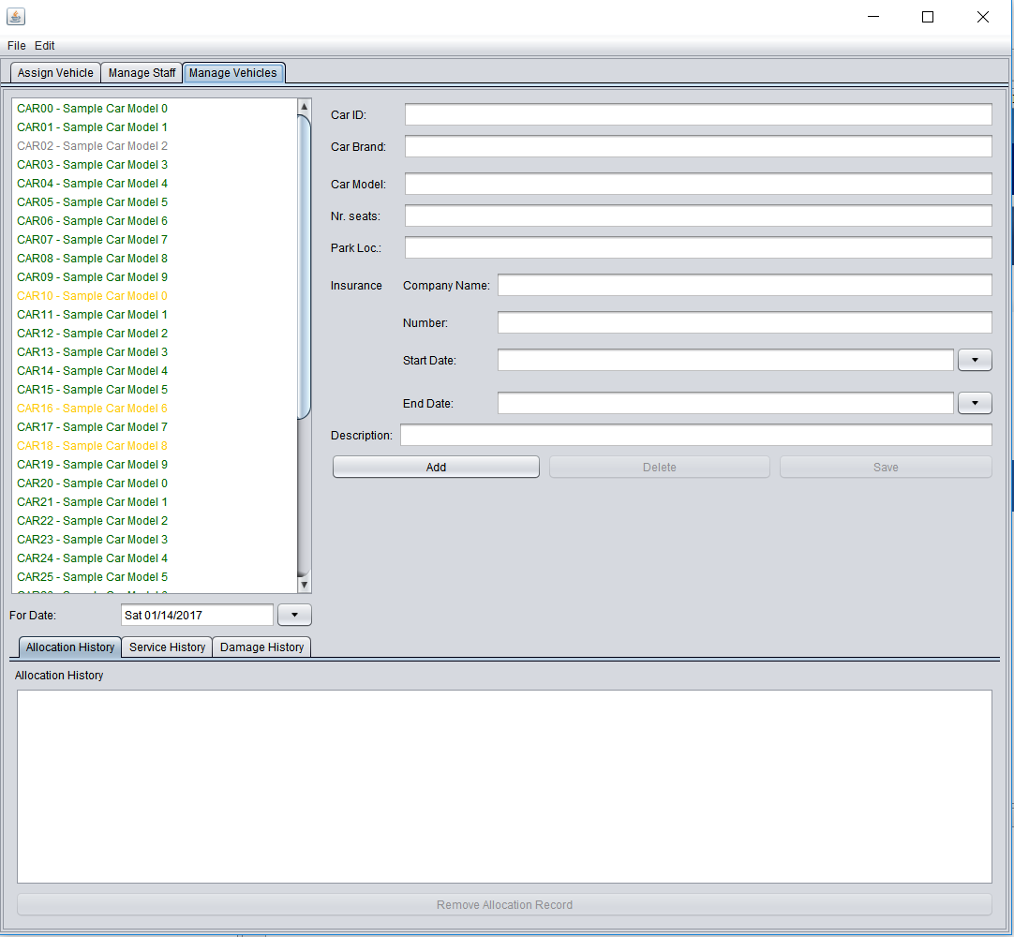
User Interface
Notes:
I will start with the user interface, which consists out of three tabs: Assign Vehicle Tab – Manage Staff Tab and Manage Vehicles Tab.
Each tab consists of multiple individual subpanels, and each have a specific class that contains their functionality.
In the next slides I will go into more detail about each tab.

Slide 3
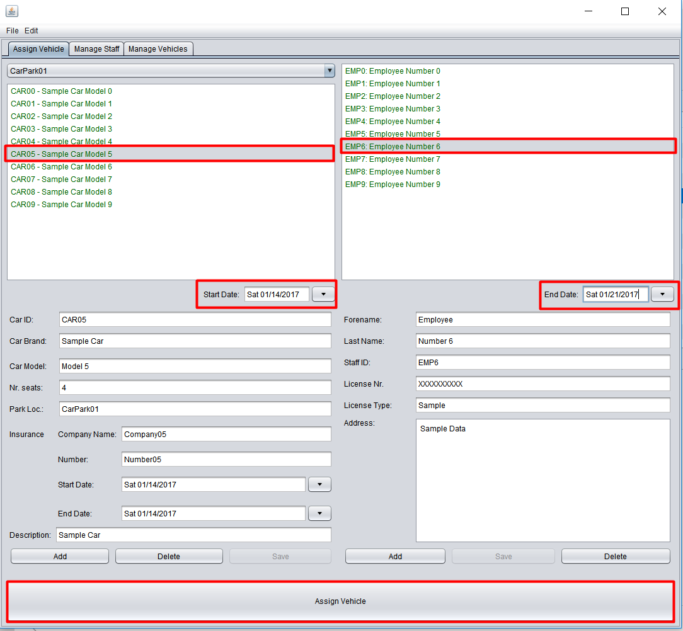
Assigning vehicles
Select an available car
Select a staff member
Select at least a ‘start date’
Select an ‘end date’ – optional for long term allocation
Click “Assign Vehicle”
Notes:
The Assign vehicle panel contains the following: a dropdown list that contains all current carparks – a list for staff and a list for vehicles, a panel that contains the information of the selected staff, a panel that holds the information of the selected vehicle and two date pickers that check for the availability of the vehicle for the selected date or interval of time.
By selecting a car, a start date and a staff member, an allocation can be registered by pressing the corresponding button.

Slide 4
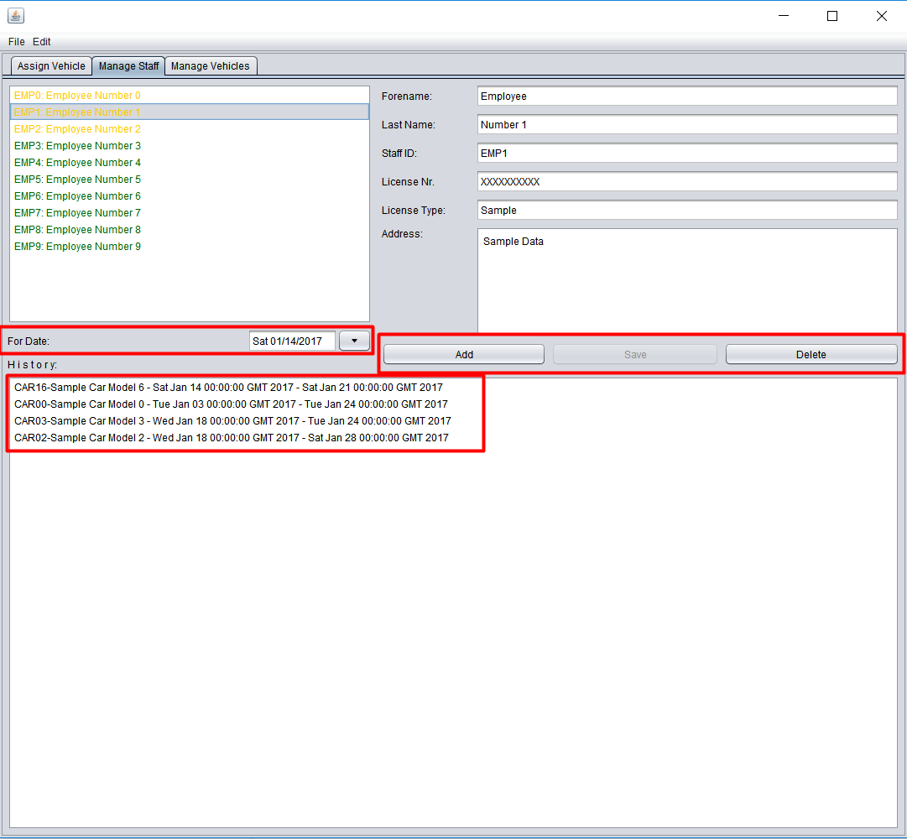
Managing employees
Allows the managing of staff members by:
Checking availability for a specific date
Adding / Deleting / Editing current staff members
Viewing allocation history
Note: Staff members that currently have for the selected date a car allocated, will be marked by yellow text.
Notes:
The managing employees tab allows the management of staff members, by registering , deleting or editing information.
The user can observe the status of a staff member by colors in the list, if the user is marked with yellow, means he has a car allocated for the selected date, else the user should be green, which indicates that he has no car assigned.
The add, edit and delete button should offer enough possibilities to manage the staff correspondingly.
In the lower half of the interface, the user can observe the allocation history of the selected staff. If allocation history needs to be changed, please use the Manage Vehicles tab.

Slide 5
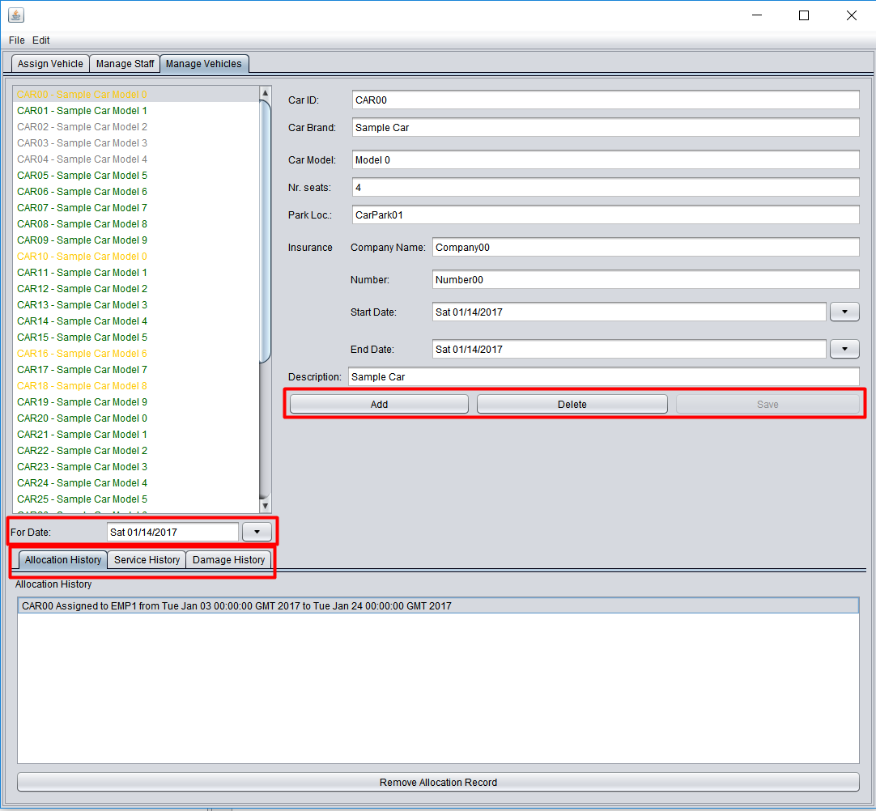
Managing vehicles
Allows the managing of registered vehicles by:
Adding / Deleting / Editing
Viewing of Allocation / Service / Damage history
Checking availability of a vehicle by selecting a date
Green – available
Yellow – allocated
Grey – in service
Red - damaged
Notes:
The manage vehicles tab offers the broad possibilities of checking, correcting and deleting information regarding a car.
Not only can a car be added, deleted or edited, but this tab allows the user to also manage allocation, service and accidents history through each individual sub-tab.
Like other tabs, the user can check the status of a car for a specific date using the date picker, as for colors: green indicates availability, yellow allocation, grey if the car is in service and red if damaged to the state of not being able to be driven anymore.

Slide 6
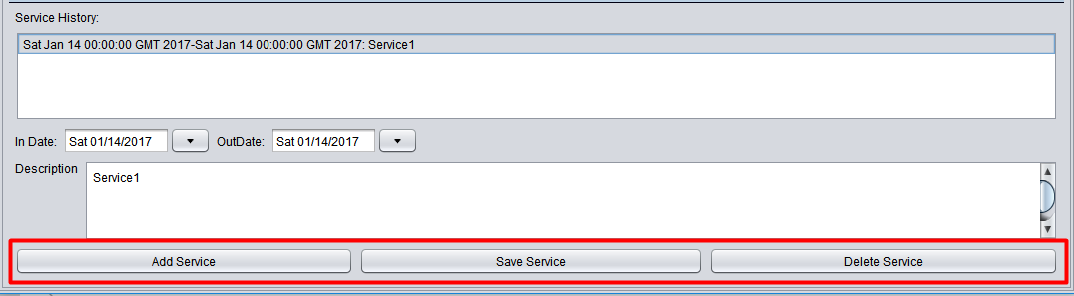
Managing service history of a vehicle
Allows management and tracking of service history by:
Viewing past and future service appointments
Adding / Editing / Deleting a service record
If a car has a service appointment pending for the selected date, the vehicle will be marked with grey text
Notes:
The manage service sub-panel allows the tracking of future and past service appointments, by adding – deleting and removing a service record. Each service record contains the date on which the car enters the service, a date for leaving it and a short description.

Slide 7
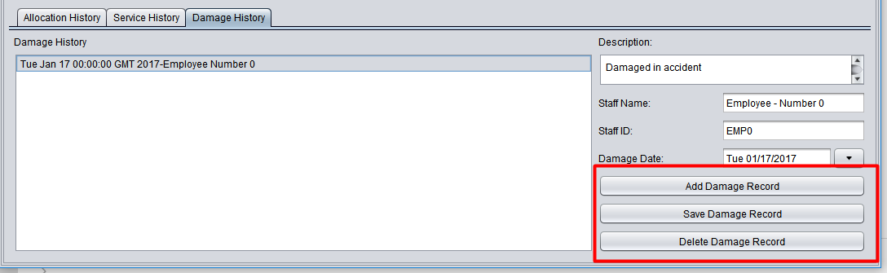
Managing damage history of a vehicle
Allows management and tracking of damage history by:
Viewing past and future accidents
Adding / Editing / Deleting a damage record
If a vehicle is unavailable due to current accidents, it will be marked by red text
Notes:
The sub-panel that manages damage history of a car, allows the user to view past accidents by adding, deleting or editing records. Each record has a damage date, a staff that was responsible and a description.

Slide 8
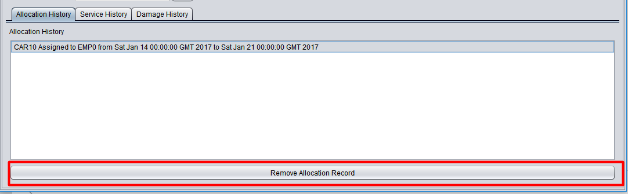
Managing allocation history of a vehicle
Allows management and tracking of allocation history by:
Viewing past and future allocations
Cancelling an allocation record
If a vehicle is allocated for the selected date, it will be marked by yellow text
Notes:
The manage allocation history sub panel, allows the observation of past and future allocations. As this interface is not meant for allocating cars to staff members and does not check for availability, it only allows the option to remove an allocation, not edit it.

Slide 9
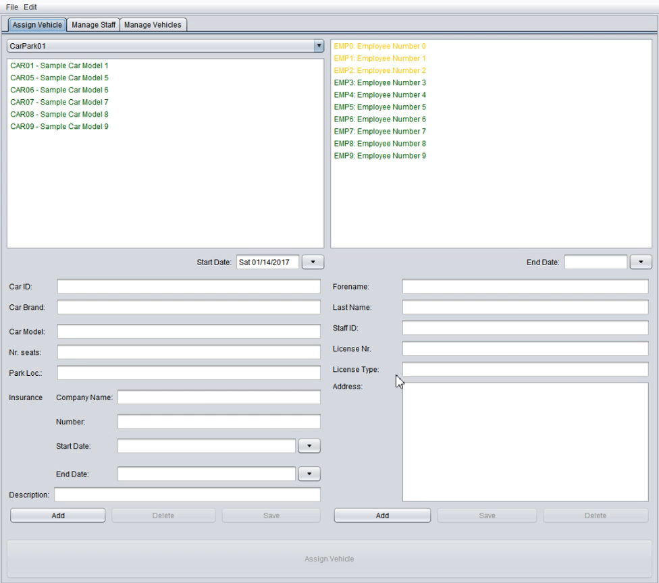
Showcase
Notes:
This is a rather long video, that presents the functionality of our program. If you wish to test it yourself, please run the executable JAR file.

Slide 10

Project development / progression
Version Control System
Collaboration
Storing versions (properly!)
Restoring previous versions
Understand what happened
Backup
Notes:
For the development of this assignment, we have agreed to use a version control system, that would improve our collaboration, would save each change made to the project and two versions between the change, would allow restoration of previous iterations, help us understand where and what happened and as any other VCS, it offers plenty of backups.

Slide 11
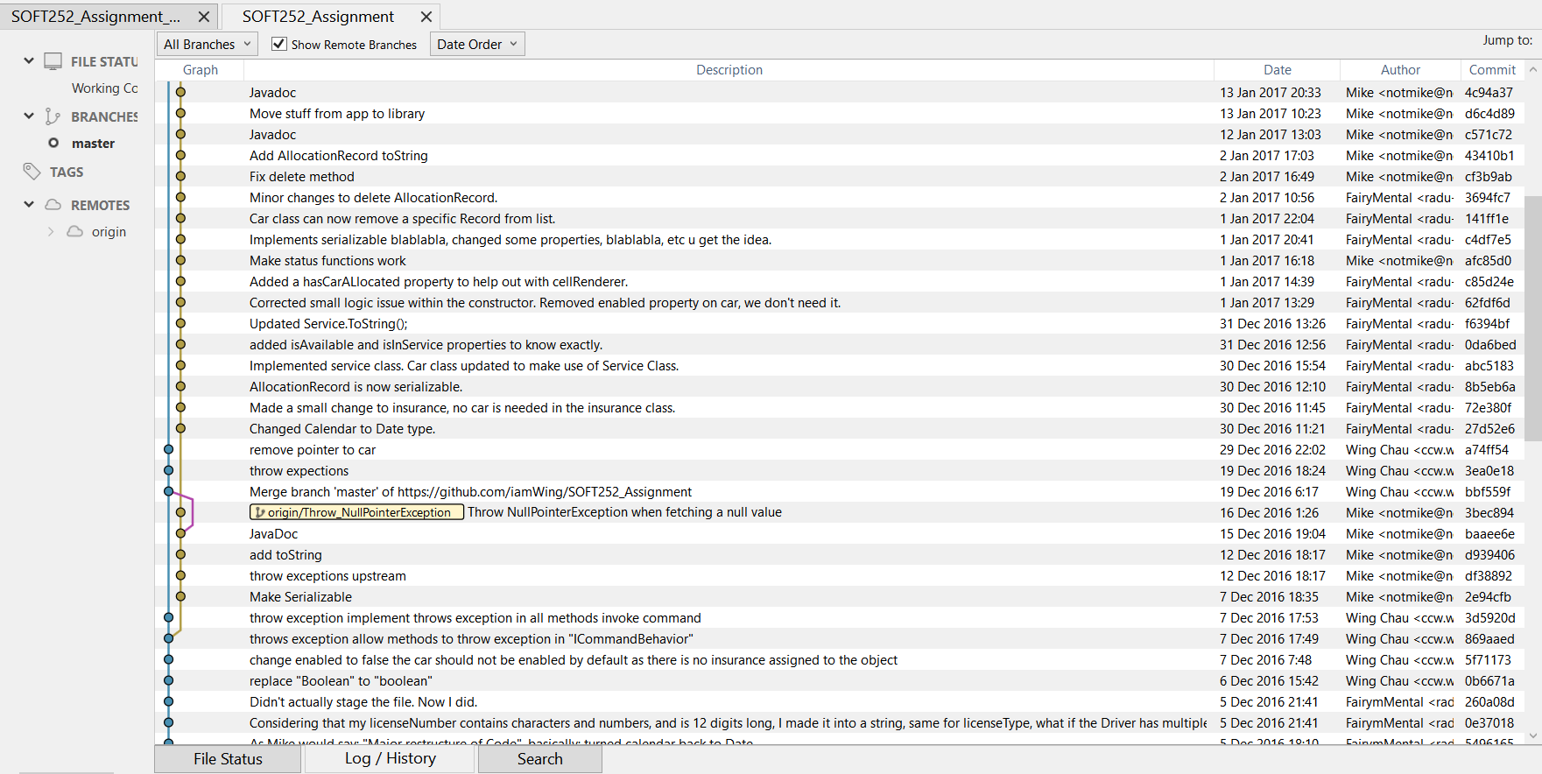
SOFT252_Library
Notes:
We have one repository for the library, and one for the graphical user interfaces, the following printscreens are examples of commits and pushes submitted by our group to github.

Slide 12
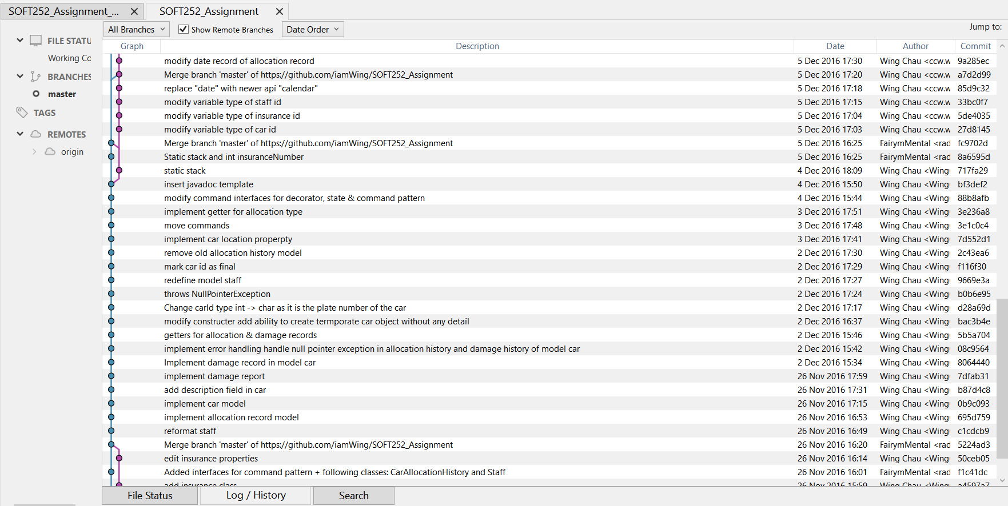
SOFT252_Library
Notes:
As it can be observed, we took VCS pretty serious, and made sure we save our current changes as often as we saw fit.

Slide 13
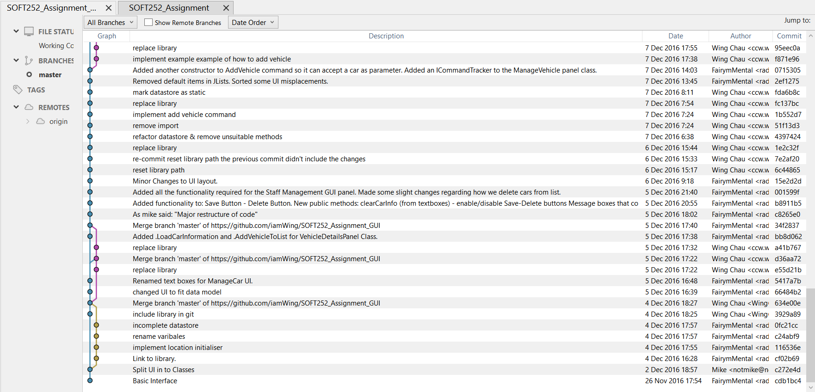
SOFT252_GUI
Notes:
The printscreens that follow, are part of the GUI repository. The only flaw of the system, is that we were needed to replace the external library of the data model into the GUI project, then push the changes once more.

Slide 14
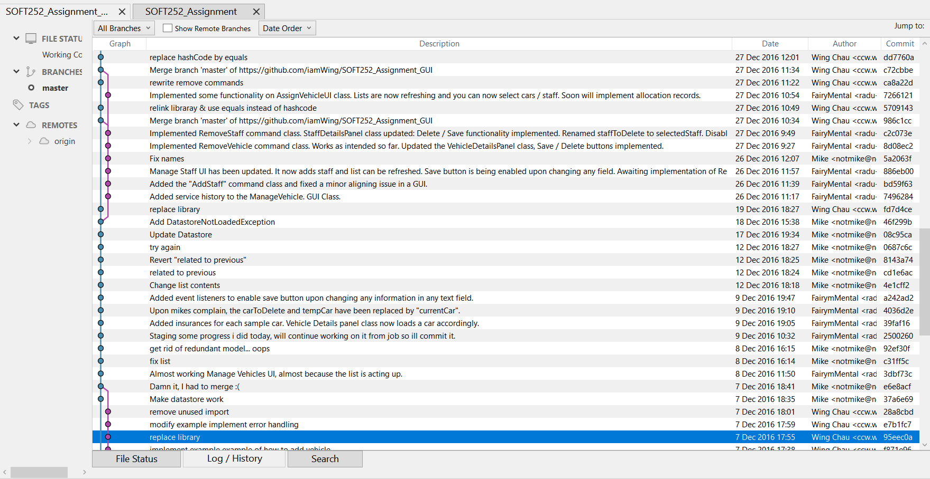
SOFT252_GUI
Notes:
Here is another printscreen of the GUI project that contains multiple commits and pushes. As it can be observed from the descriptions, some commits were larger, some were smaller.

Slide 15
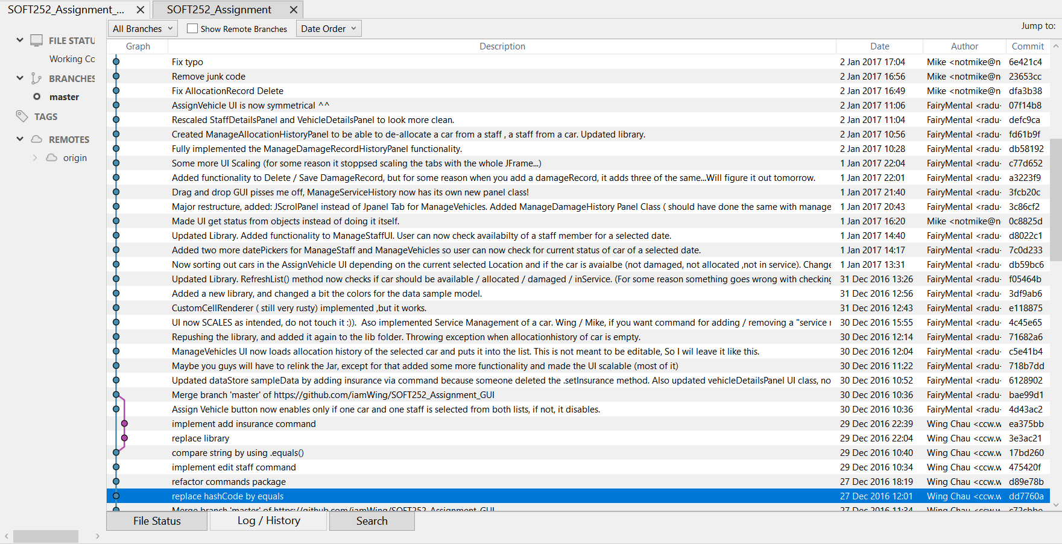
SOFT252_GUI
Notes:
We would like to maintain our repositories private, if any teacher or staff would like to access the repositories, please e-mail Wing, sending him the username of your GIT account and he shall send you an invite.

Slide 16
Good programming practices
Object oriented design
Modular Software design
Test driven development
Auto –generated documentation
Easy to read code (Comments / indents / etc.)
Version Control system used accordingly
One repository for each project
Open Communication (Whatsapp group conversation and detailed commit descriptions)
Notes:
Throughout this first term, we have attempted the follow the best practices of programming by developing an object-oriented and modular software design on the GUI, having a separate class for each panel – by working on the project adopting the test driven development, by saving time auto-generating most of the documentation and by making the code and as well the comments as easy as possible to read.
We worked like a group of professional free-lancers, we communicated, we discussed our problems, we devided our work and we implemented everything using a VCS repository for each project.

Slide 17
Questions?

